Slide 1
Expenditure Data Analysis

Slide 2
Objective
To run government it is important to manage expenses
It is the way by which government can handle its economy
So in this project we are going to analyse some key feature that describes how well state government is in managing its economy
For this purpose we will get data from NITI aayog
The NITI AAYOG is the public policy think tank of the government of India, established with the aim to achieve sustainable development goals with cooperative federalism by fostering the involvement of state governments of India in economic policy making process using bottom-up approach

Slide 3
Benefits
To monitor government expense
To dilute various expense of various department
To make decision for future budget allotment
Profitability review

Slide 4
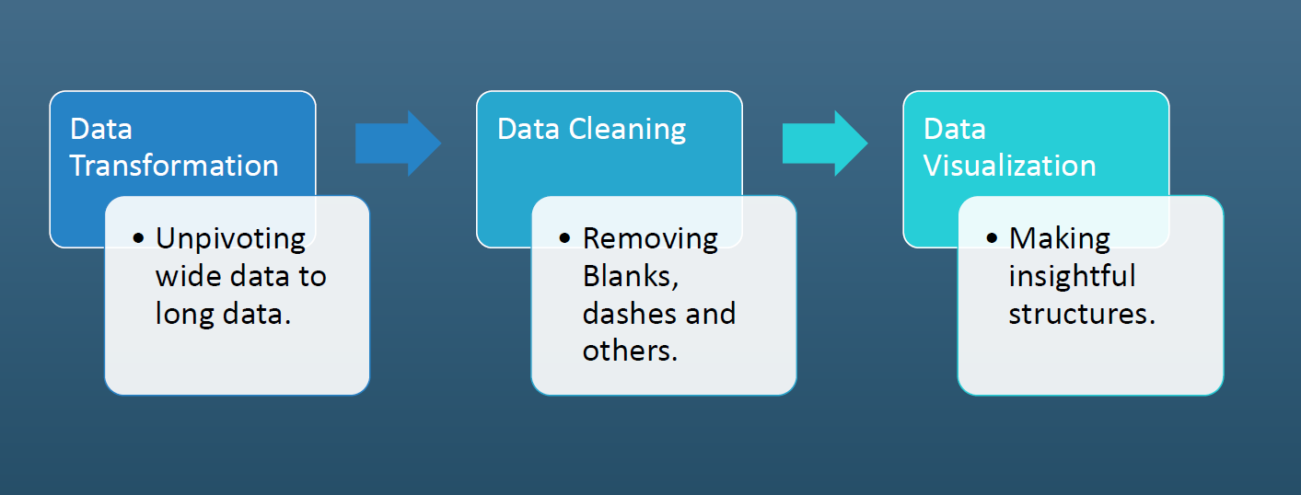
Architecture

Slide 5
Data Preparation
In preparation process we will convert our original data set with other necessary attributes
As you all can notice that format of that data we have is not good to analyse
As this is pivoted dataset we need to unpivot it that’s the only way we can make meaningful insights from it

Slide 6
Data Validation
The data we have contains blank or “ “--” values. We have to fill them with Zero(0) to make values column a proper numerical column.
In Excel we can do that by selecting the whole column,
1. Click on “Find and select” and then “Find” to replace all “ “--” values with “
2. Click on “Find and select” and then “Go To Special” to replace all Blanks with “0”.
Next, In the years column some data points have extra text. To remove them, we can create a new column with formula “=Right(C2,7)” and apply it for whole column to select only year range from Years column and replace it with original Years column.

Slide 7
Make MS Excel connection and set up the data base
Configuring Power bi
1. After you open Tableau, under Connect, click Excel.
2. Select the Excel workbook you want to connect to, and then click Open.
3. On the Data Source page, click the sheet tab to start your analysis.

